Slide 2
Sanctity of Human Life Sunday

Slide 3
19 week old preborn child

Slide 4
Life: the condition that distinguishes animals and plants from inorganic matter, including the capacity for growth, reproduction, functional activity, and continual change preceding death.
Sanctity: the state or quality of being holy, sacred, or saintly.
Sacred: revered due to association with holiness.

Slide 5
Genesis 1:27 –
“So God created man in His own image; in the image of God He created him; male and female He created them.”

Slide 8
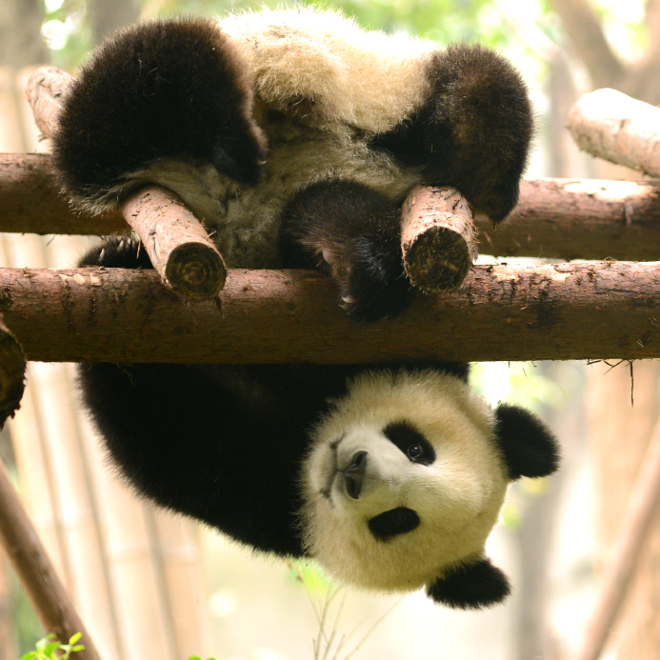

Slide 10
Where there is love there is hope; where there is hope there is LIFE.

Slide 11
Photo used with permission – Grove City College

Slide 12
Used with permission – Alison Adams

